Slide 1
REFLECTION
Year 9

Slide 2
Learning Objective:
To be able to use a light box.
To investigate the reflection of light.
Understand the Law of Reflection
Understand the difference between diffuse and clear reflection

Slide 3
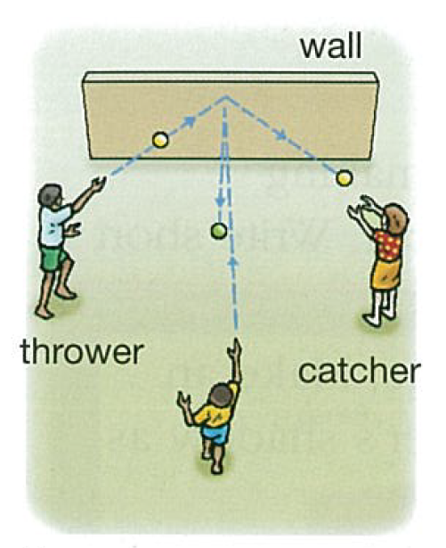
Starter…
Who can catch a ball off the wall that someone else has thrown?

Slide 4
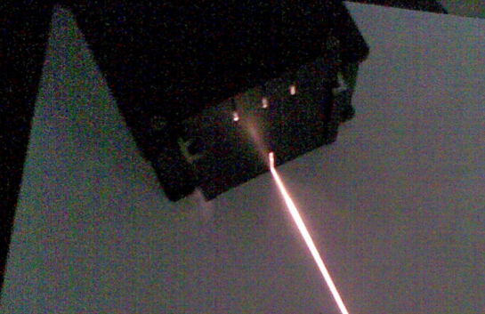
Light Ray Boxes
Each group get a box and powerpack.
You have 5 minutes to try and create a single “ray” of light:
POWERPACKS:
DC sockets
Maximum 6V

Slide 5
Backs to seats…
Everyone get a piece of A4 paper.
Now copy this (PENCIL and RULER):

Slide 6
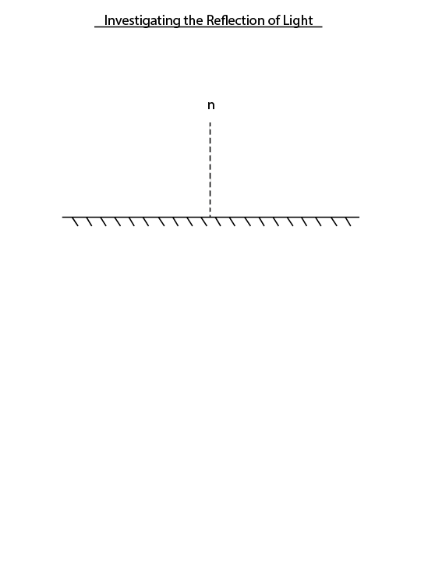
A closer look…

Slide 7
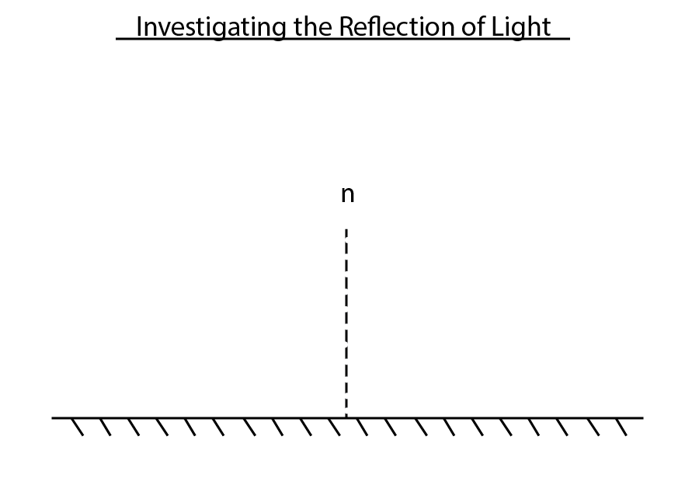

Slide 8
What does it mean??
normal
= a line at 90º to the surface
a plane mirror
(flat – not curved)

Slide 9
Now…
Place a mirror where the plane mirror is on your paper.
Shine the light ray at the point where the normal meets the mirror.
When finished, call me over to check!

Slide 10
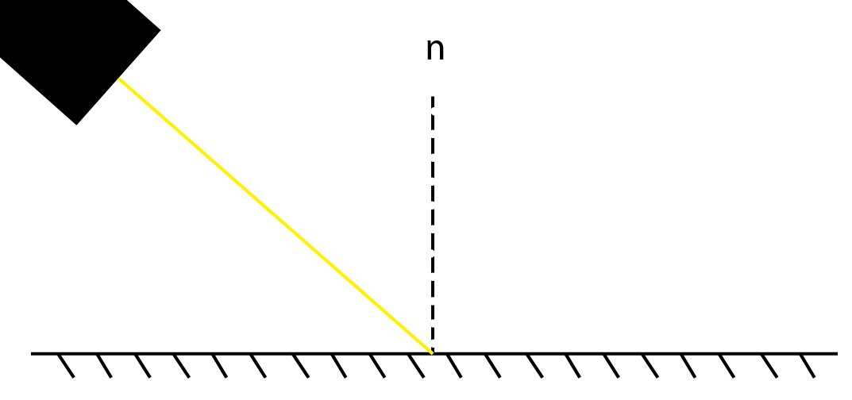
Mark the start and end of the light ray with an dot…

Slide 11
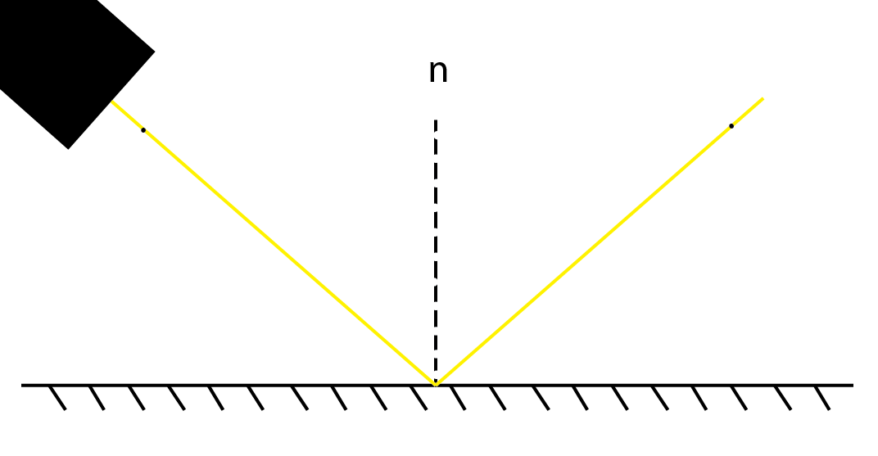

Slide 12
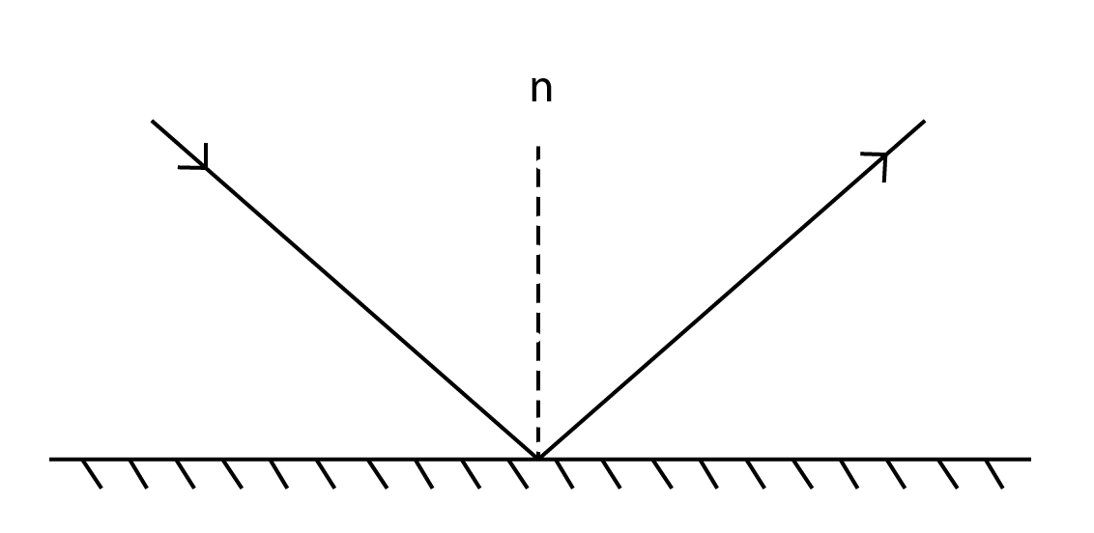
Now draw in the light rays and arrows to show direction:

Slide 13
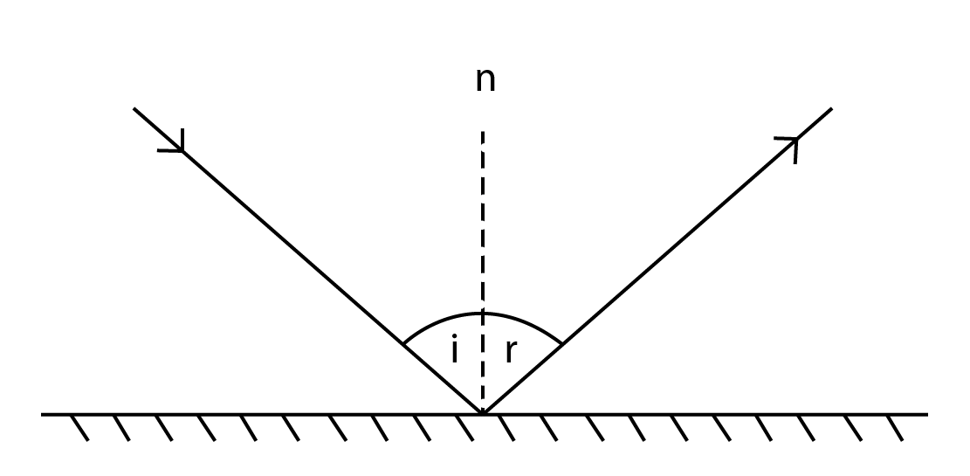
You know have your first angles!!

Slide 14
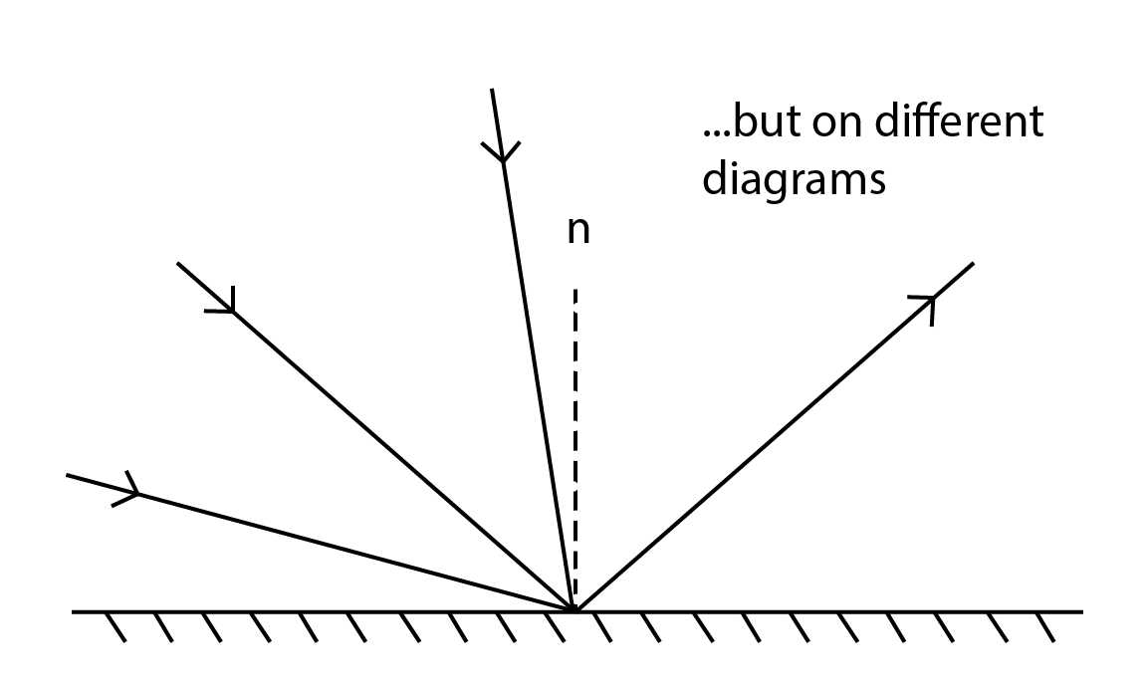
Now measure these two angles, and write them under your picture:
i = ??º r = ??º
What do you notice about these angles?
Repeat twice more, drawing the diagrams again, with very different angles for “i”.

Slide 15
Reflection
Reflection from a mirror:
Normal
Incident ray
Reflected ray
Angle of incidence
Angle of reflection
Mirror

Slide 16
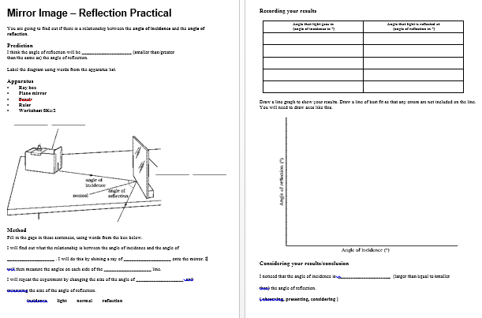
Class Practical (30 mins)
Be careful with the light boxes, they can get VERY hot quite quickly!!
Resources:
Protractor
Pencil
White paper
Ruler
Mirror
Light box

Slide 17
The Law of Reflection of Light
With your group, using what you have just discovered…
Try and write a “law” (rule) for angles i and r.
When light hits a reflective surface, the angle of incidence (i) and the angle of reflection (r) are equal.
i = r

Slide 18
The Law of Reflection
Angle of incidence (i) = Angle of reflection (r)
In other words, light gets reflected from a surface at the _____ angle it hits it.
same !!!

Slide 19
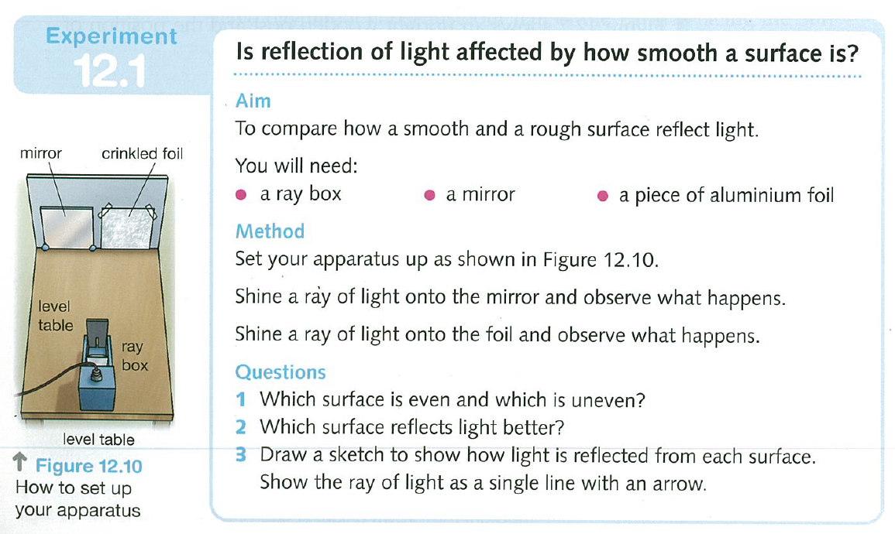
Now carry out another investigation:
A new piece of paper…

Slide 20
Clear vs. Diffuse Reflection
Smooth, shiny surfaces have a clear reflection:
Rough, dull surfaces have a diffuse reflection.
Diffuse reflection is when light is scattered in different directions

